Slide 1
TECHNICAL WRITING Dr. Ratna Rao

Slide 2
Technical Writing Process & Product
Steven M. Gerson
Sharon J. Gerson

Slide 3
Ludo Rules
A Ludo board is square with a pattern on it in the shape of a cross, each arm being divided into three adjacent columns of eight squares. The middle squares form the home column for each colour and cannot be landed upon by other colours. The middle of the cross forms a large square which is the 'home' area and which is divided into 4 home triangles, one of each colour. At each corner, separate to the main circuit are coloured circles (or squares) where the pieces are placed to begin.

Slide 4
Winning
When a piece has circumnavigated the board, it proceeds up the home column. A piece can only be moved onto the home triangle by an exact throw.
The first person to move all 4 pieces into the home triangle wins

Slide 5
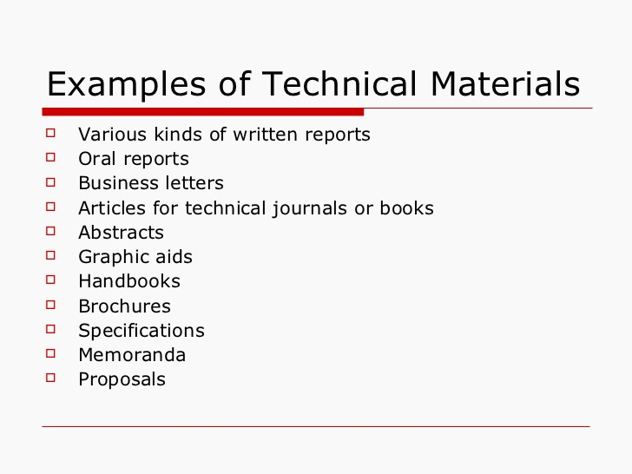

Slide 6
 | Technical Writing
Audience
Purpose
Format
Style
Liability
 | Academic Writing | Technical Writing
Audience
Purpose
Content
Document Life Span
Liability
Writing Style
Formats
Design Elements

Slide 7
Definition :
Technical writing is communication written for and about business and industry, focussing on products and services, how to manufacture them, market them, manage, deliver and use them.

Slide 8
WHAT IS TECHNICAL WRITING?
Pertains to a technical subject
Has purpose, conveys facts/data
Has an objective, can be archived
Impersonal and Concise
Is directed, has specific format

Slide 9
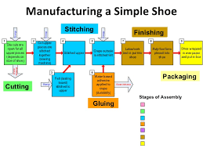
Well here I sit with broken ankle Got my feet caught in a tangle One went left and one went right I went down as if I were in a fight Had to have surgery with plates and pins Inserted in my bones so I could mend While I'm healing I have lots of time To think about the shoes I'll find Ones that do not have open toes To make me fall and bust my nose Now when I get dressed to go to church Through my closet I will search No sandals or high heels will you find On me wearing at any time No the only shoes that I will wear Are Tennis Shoes with special care

Slide 10
Purpose of Technical Writing:
Inform
Explain
Summarize
Instruct
Evaluate
Recommend
Persuade or convince

Slide 11
Importance of Technical Writing:
Business
TIME
MONEY
Team work
Collaboration

Slide 12
Importance of Technical Writing:
Business:
Through technical writing employees
Maintain good customer-client relations (follow up letters)
Ensure that work is completed in time (e-mail/memos)
Provide document that work is completed (progress reports)
Generate income (sale letters, brochures, fliers)
Keep machinery working (User Manuals)
Ensure that correct equipment is purchased (technical description)
Participate in teleconferences and video conferences ( oral communication)
Get a job ( resume)
Define terminology (online help screen)
Inform the world about your company and products ( Internet websites)

Slide 13
Money
Cost of correspondence
Percentage of salary
Generating income

Slide 14
Bruce, a research chemist for a major petro-chemical company, wrote a dense report about some new compounds he had synthesized in the laboratory from oil-refining by-products. The bulk of the report consisted of tables listing their chemical and physical properties, diagrams of their molecular structure, chemical formulas and computer printouts of toxicity tests. Buried at the end of the report was a casual speculation that one of the compounds might be a particularly effective insecticide.
Seven years later, the same oil company launched a major research program to find more effective but environmentally safe insecticides. After six months of research, someone uncovered Bruce’s report and his toxicity tests. A few hours of further testing confirmed that one of Bruce’s compounds was the safe, economical insecticide they had been looking for.
Bruce had since left the company, because he felt that the importance of his research was not being appreciated.

Slide 15
The Acme Electric Company worked day and night to develop a new current regulator designed to cut the electric power consumption in aluminum plants by 35%. They knew that, although the competition was fierce, their regulator could be produced more cheaply, was more reliable, and worked more efficiently than the competitors’ products.
The owner, eager to capture the market, personally but somewhat hastily put together a 120-page proposal to the three major aluminum manufacturers, recommending that their regulators be installed at all company plants.
She devoted the first 87 pages of the proposal to the mathematical theory and engineering design behind his new regulator, and the next 32 to descriptions of the new assembly line she planned to set up to produce regulators quickly. Buried in an appendix were the test results that compared her regulator’s performance with present models, and a poorly drawn graph showed how much the dollar savings would be.
Acme Electric didn’t get the contracts, despite having the best product. Six months later, the company filed for bankruptcy.

Slide 16
Money (Case Study)
On July 22, 1962, at 9:20 PM, the Mariner I sat idly on its platform, ready to make history. After investing years of construction, calculation, and funding, NASA had high hopes that its rocket would successfully conduct a flyby survey of Venus, thus shifting the Space Race's momentum back to the home front. In every way, it was poised to set a space travel precedent.
But when the rocket embarked, it was clear there'd be no cause for celebration: less than 5 minutes into flight, Mariner I exploded, setting back the U.S. government $80 million ($630 million in 2014 dollars). The root cause for this disaster? A lone omitted hyphen, somewhere deep in hand-transcribed mathematical code.

Slide 17
In a survey that was conducted in 2004 by the National Commission on business writing among some 120 American companies, it was estimated that major corporations spent over $3.1 billion on employees’ deficiencies in writing. Additionally, about 74% of web browsers were found to pay attention to the quality, grammar, and spelling of company websites. More than 59% of people were found to prefer not doing business with a company which has an obvious mistake in grammar in their write-ups.
The problem is, the internet has converted the business world into a small village, and such figures can translate to huge losses.

Slide 18
TIME
Joanne supervised 36 professionals in 6 city libraries. To cut the costs of unnecessary overtime, she issued this one-sentence memo to her staff:
When workloads increase to a level requiring hours in excess of an employee’s regular duty assignment, and when such work is estimated to require a full shift of eight (8) hours or more on two (2) or more consecutive days, even though unscheduled days intervene, an employee’s tour of duty shall be altered so as to include the hours when such work must be done, unless an adverse impact would result from such employee’s absence from his previously scheduled assignment.
After the 36 copies were sent out, Joanne’s office received 26 phone calls asking what the memo meant. What the 10 people who didn’t call about the memo thought is uncertain. It took a week to clarify the new policy.

Slide 19
Five days after the ill-fated launch, a New York Times headline harped on the minuscule typo — "For Want of Hyphen, Venus Rocket is Lost" — and the paper's story reported that the error had been the result of "the omission of a hyphen in some mathematical data." Purportedly, a programmer at NASA had left out the symbol while entering a "mass of coded information" into the computer system.
The same week, Richard B. Morrison, a NASA official, presented a case for the rocket's destruction before Congress and stressed the significance of the tiny omission:
"[The hyphen] gives a cue for the spacecraft to ignore the data the computer feeds it until radar contact is once again restored. When that hyphen is left out, false information is fed into the spacecraft control systems. In this case, the computer fed the rocket in hard left, nose down and the vehicle obeyed and crashed.

Slide 20
Collaboration
In business and industry, many user manuals, reports, proposals, PowerPoint presentations, and Web sites are team written. Teams consist of engineers, graphic artists, marketing specialists and corporate employees in legal, sales, production, accounting, and management. The collaborative efforts include communicating with companies in other cities and countries through teleconferences, faxes, and e-mail

Slide 21
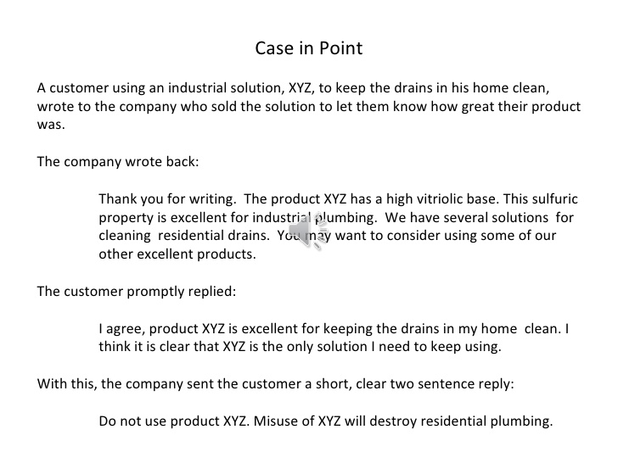

Slide 22
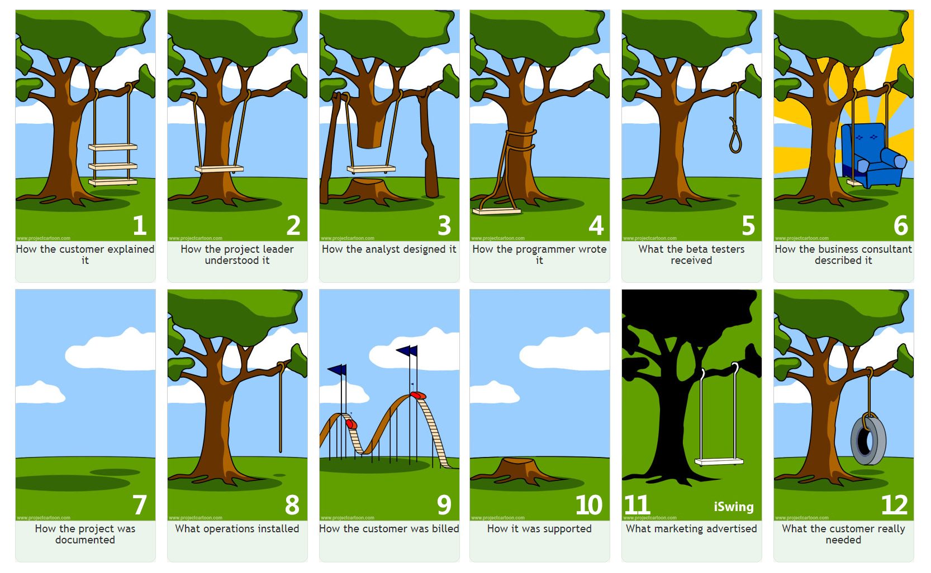

Slide 23
Silo
An attitude within an organization when the different sections or departments do not share information properly because they do not want to share success with others, with the result that the organizations is not efficient.
Macmillan

Slide 24
Silo Building
Silo Building: The silo has become a symbol for departments and employees that behave as if they have no responsibilities outside their areas. They act as if no other department’s concerns or opinions are valuable. Such “stand-alone” departments or people isolate themselves from the company as a whole and become inaccessible to other departments. They “focus narrowly”. The successful employee must be able to work collaboratively with others to share idea

Slide 25
Silo Building Case Study
In the defense industry where there is a great deal of collaborative work between companies to complete a finished product, focusing only within one’s silo can have dangerous consequences.
In both the Challenger and the Columbia explosions, not all of NASA’s subcontractors communicated properly with each other and with NASA as to the risks entailed in their contributions to the constructing and
evaluating the structure of the shuttle in question. And within NASA itself, very simply put, it appears that many engineers and managers seemed each to have had different perceptions of the risks involved on those launches, and neither (and there were others) understood the mind sets (and thus the risk analyses) of the other.

Slide 26
On January 28, 1986, the space shuttle Challenger broke apart 73 seconds into its ascent. An O-ring seal in its rocket boosters failed due to complications from a known design flaw that caused superheated gases to vent through the seal. In fact, that wasn't the only issue that NASA technicians were aware of: the O-ring had never been tested in temperatures as cold as those that morning

Slide 27
contd:
According to both the Challenger and Columbia government reports, because of its many successful launches, the culture at NASA was rooted in a basic conviction that they were invincible, despite these 2 horrendous accidents. Moreover, at NASA, there was a well documented logic of strict hierarchy. Engineers assumed that managers were in charge of decision-making. Raising issues or questioning a decision was not encouraged and genuine exchanges of ideas and suggestions were not part of the practice at NASA A third characteristic of this culture, and this was part of the invincibility mind set was the belief that if something
worked, and worked repeatedly, it should not be tampered with.

Slide 28
People in the decision-making process were invested in the results they wanted and didn't critically analyze the information given. There was resistance to pushing back the launch, which meant that the technical evidence was interpreted in a hostile light.
NASA relied on incomplete data. The O-rings had been tested, just not in the right conditions. But that incomplete data informed the launch.
Engineers didn't have the persuasive power they needed. The data available were inconclusive enough to raise questions, but not enough to definitively say something was wrong. That meant that possible safety concerns had to be weighed against the mission schedule.
In many cases, the chain of reporting was ignored. Information never made it through the channels it needed to.

Slide 29
Case Study Silo Building (breaking the Silo building)
Leaders there are being incredibly proactive in their collaborative leadership efforts, with a very clear purpose. While already running the world’s busiest airport (passenger traffic grew to almost 66.5 million in 2013, a 15% rise on the previous year), they recognized that to achieve their vision of becoming the world’s leading airport company, they need to drive a new service culture through the 3,400-person organization. But they knew they couldn’t make a meaningful change in their culture alone. To change customers’ real experience of Dubai Airports, they needed to engage their vendors and partners as well.
One of the outcomes is a customer-service training program that is being rolled out over a three-year period across many stakeholder organizations and 43,000 employees. The Dubai Airports team is investing in training for over 39,000 people outside of their own organization, aiming to ensure behavioral consistency and therefore customer experience consistency at every possible touch point.

Slide 30
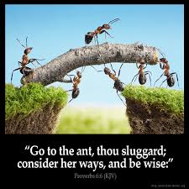
Why Teamwork is important?
Diversity of opinion
Checks and balances
Broad-based understanding
Empowerment
Team building-vision/mission
Resolves Conflicts
Increases Productivity

Slide 31
What Qualities must be there for success in teams?
Interdependence
Commitment towards team
Open communication and positive feedback
Team composition
Accountability

Slide 32
What skills Employers want?
Interpersonal
Teamwork
Analytical
Oral Communication
Flexibility
Computer
Written communication
Leadership
Work experience
Internship/co-op experience

Slide 33
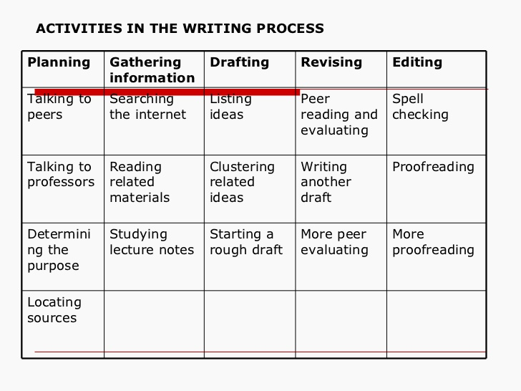

Slide 34
FIVE COMPONENTS OF WRITING
Development
Grammar
Style
Organization
Document design

Slide 35
Sexist Language
Radium was discovered by a woman, Madam Curie
Unequal Treatment
Using Modifiers
The poor woman could no longer go on; the exhausted men..
Mrs Acton, a blonde is Joe’s secretary.
Stereotyping
The secretary brought her boss his coffee.
The teacher must be sure that her lessons are well-prepared.
The trainer was given his remuneration in time.
Pronouns
A good lawyer will make sure that his clients are aware of their rights.

Slide 36
Nouns
Biased | Unbiased
People | workers, personnel
The common man | the average citizen
Wise men | leaders
Chairman | chairperson
Steward/ess | Flight attendant
Waiter/ess | server

Slide 37
Dear Sir
Interested in beautifying your company property, with no care or worries? We have been in Business for over 25 years helping men just like you. Here’s what we can offer:
Shrub Care: Your workmen will no longer need to water shrubs. We’ll take care of that with a sprinkler system geared toward your business’s unique needs.
Seasonal System Checks- do not worry about your foreman having to ask his workers to turn on the sprinkler system in the spring or turn it off in the winter. Our repairman take care of that for you as part of our contract.
New Annual Plantings-we plant rose bushes and daffodils that are so pretty, your secretary will want to leave her desk and pick a bunch for her office. Of course, you might want to do that for her yourself.
Trees- we do not just plant annuals. We can add shade to entire property. Just think how beautiful your parking lot will look with elegant elms, oaks and maples. Then, when you have that company picnic, your employees and their wives will be surrounded by nature.
Call today for prices. Let our skilled craftsmen work for you!
Sincerely
Richard White

Slide 38
Audience Involvement
Pronouns Used -
You/your-the reader.( most preferred)
We us our- The team( second- for the writer)
I Me My- The ego
Claims Procedure
To obtain service under the Emissions Performance Warranty, take the vehicle to the company dealer as soon as possible after it fails an I/M test along with documentation showing that the vehicle failed an EPA-approved emissions test.
How do you get service under the Emissions Performance Warranty? To get warrant under this warranty, take your car to the dealer as soon as possible after it has failed an EPA-approved test. E sure to bring along the document that shows your car failed the test.

Slide 39
Rewrite using unbiased language
The finishing plant was the scene of a confrontation today when two ladies from the morning shift accused a foreman of sexual harassment. Marilyn Humphrey, a black inspector, and Margaret Sawyer, an assembly-line worker, accused Mr rand of making suggestive comments. Mr rand, who is 62 years old and an epileptic, denies the charges and said that he thought the girls were trying to gyp the company with their demand for a cash award.

Slide 40
Dear Sir
With regard to lost policy 123, enclosed is a lost policy form. Complete this form
and return it ASAP. Upon receipt, the company will issue a replacement policy.
Dear Mr Gupta
Your lost policy 123 can be replaced easily. I’ve enclosed a form to help us
replace it for you. All you need to do is fill it out for us. As soon as we get it, we’ll
Send you your replacement policy.

Slide 41
Names- first name/surname
Contractions
Reader benefit-give what they want
A poured foundation will provide a level surface for mounting both the pump and motor. Carefully aligned equipment will provide you a longer and more easily maintained operation.

Slide 42
Verbs that establish facts:
concluded, passed, approved, developed discovered, deduced, failed solved.
Verbs that do not establish facts:
May be, perhaps, likely, suggest, suppose…

Slide 43
What is a simple sentence?
It is easy to read
It makes a single point
It is short. The preferred length is 15-20 words.
The message can be read in single reading
It creates no ambiguity.
We saw her duck

Slide 44
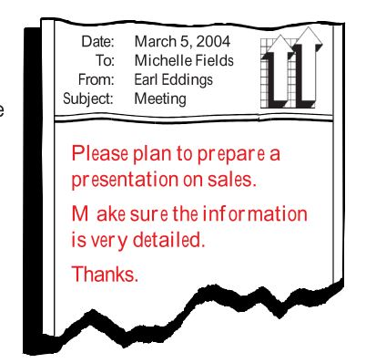
Technical Writing Traits
Clarity

Slide 45
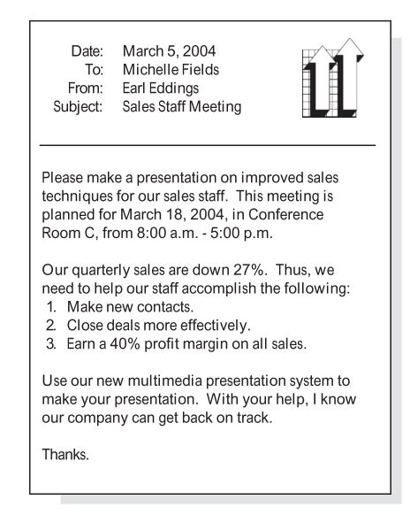

Slide 46
Conciseness
A sentence should contain no unnecessary words, a paragraph no unnecessary sentences, for the same reason that a drawing should have no unnecessary lines and a machine no unnecessary parts.
William Strunk.jr.

Slide 47
Writing shorter sentences techniques-
Spilt and disconnect
I understand that some doctors making night calls have been attacked in recent months on the expectation that they were carrying drugs and their caution when visiting certain areas in the south of the city has been very exacting and has even included telephoning the address to be visited from their car when they arrive outside the house. B. I understand that some doctors making night calls have been attacked in recent months on the expectation that they were carrying drugs. Their caution when visiting certain areas in the south of the city has been very exacting. It has even included telephoning the address to be visited from their car when they arrive outside the house.

Slide 48
Writing shorter sentences techniques-
Spilt and connect
Winston Churchill was a great politician and statesman. He also won the Nobel Prize for literature.
This is my sister. Her name is Mira.
Say less
Use a list
Cut verbiage:
Advance warning, free sale, Actual fact, Major breakthrough, past history, plan ahead.
Bin the sentence and start again

Slide 49
1.Reduce phrases to single words.
Avoid There is, There are, and There were as sentence openers.
Don't overwork modifiers. “So avoid using the word 'very' because it's lazy. A man is not very tired, he is exhausted. Don't use very sad, use
morose. Language was invented for one reason, boys - to woo women - and, in that endeavor, laziness will not do”.
Avoid redundancies.
Use active verbs.
Writing shorter sentences techniques-

Slide 50
Don't try to show off.
Cut empty phrases.
Avoid using noun forms of verbs-
The use of verbs as replacements for nouns helps in the development of a simple style of writing.
Replacing nouns with verbs simplifies your writing

Slide 51
 | All things considered, Connecticut's woodlands are in better shape now than ever before. All things considered, Connecticut's woodlands are in better shape now than ever before.
 | As a matter of fact, there are more woodlands in Connecticut now than there were in 1898. as a matter of fact, There are more woodlands in Connecticut now than there were in 1898.
 | As far as I'm concerned, there is no need for further protection of woodlands. As far as I'm concerned, there Further protection of woodlands is not needed.

Slide 52
Redundancies
Advance reservation
Add an additional copy
Armed Gunmen
ATM machine
Blend together
Completely filled
Descend down.
We currently have vacant rooms
Get to the point as quickly as possible

Slide 53
Can this be simpler?
Your presence is highly solicited.
This is to inform you that the meeting will be held on July 26,2017.
It will be extremely difficult for us to consider your application of leave
Looking into the azure blue sky we could see the golden or of the sun slip gently beneath the Western sky.

Slide 54
vague: Consumer demand is rising in the area of services.
Precise: Consumers are demanding more services.
Vague: Strong reading skills are an important factor in students' success in college.
Precise: Students' success in college depends on their reading skills
Vague: Photography took on new aspects during the Civil War.
Precise: The Civil War saw the advent of graphic battlefield photography.

Slide 55
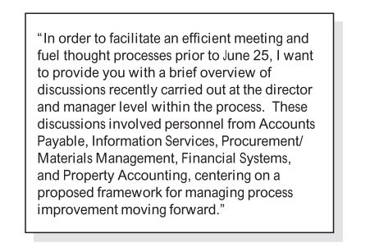

Slide 56
I wish to express indebted gratitude and special thanks to Ms. Ruchi Pawar, my zonal manager. In spite of being extremely busy with her duties she took time out to hear, guide and keep me in the right track. she allowed me to carry out my project at their esteemed institute.

Slide 57
Basically, I'm learning to write. Writing grammatically is totally difficult because of all the tenses, parts of speech, punctuation, etc. I kind of want to learn irregardless. Each and every paper that I write has improved, in terms of grammar. Firstly, I've been working on my sentence structure and also my spelling. Secondly, I've been trying to get rid of awkward phrases that plague my writing. I got a B+ on my last paper! Being as I've worked literally hundreds of hours to improve, this is totally an accomplishment. Due to the fact that my English teacher stresses the importance of grammar, every student in my class is essentially learning it, whether he/she wants to or not. And he/she had ought to continue to read a lot, since reading is equally as important as writing. As to whether you like my writing, I hope it is considered to be easy to understand. Well, I've got to go to work and/or shopping. Irregardless, I literally must say goodbye!

Slide 58
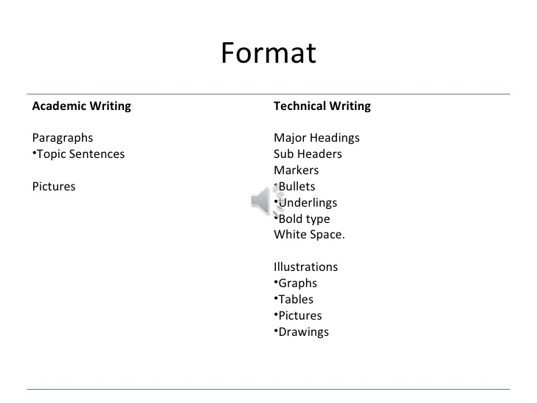

Slide 59
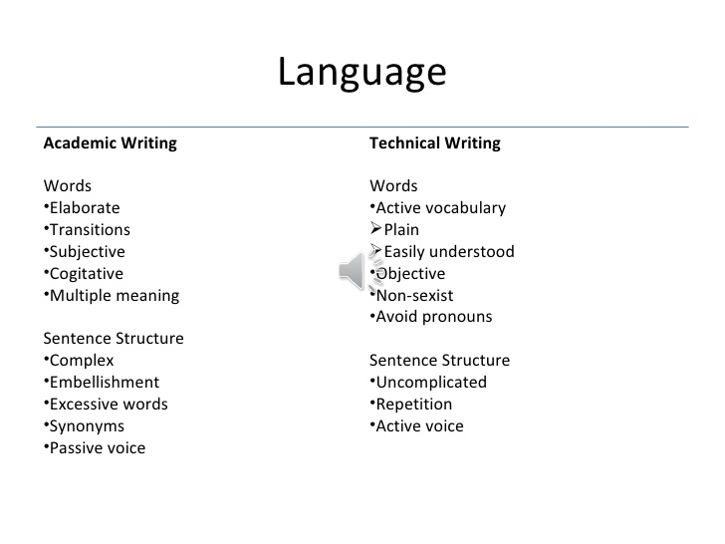

Slide 60
FORMAT
Introduction
Procedure
Results
Discussion
Recommendations

Slide 61
UNDERSTANDING WRITTEN COMMUNICATION
Single Reader, multiple readers, unintended readers
No opportunity of clarification or seeking feedback
Establishing a context
Closing the message

Slide 62
Elements of Written Communication
Technical Elements Elements of form
Words Sentence Length
Sentences Vocabulary-choice of words
Paragraphs Coherence and Transition
Grammar
Punctuation
Structure

Slide 63
Euphemisms
Ethnic Cleansing
Enhanced interrogation
Kicked the bucket
Correction facility
Differently abled
Domestic engineer

Slide 64
Conciseness
1.At this point in time we can't ascertain the reason as to why the screen door was left open.
We don't know why the screen door was left open.
2.My sister, who is employed as a nutritionist at the University of Michigan, recommends the daily intake of megadoses of Vitamin C.
My sister, a nutritionist at the University of Michigan, recommends daily megadoses of Vitamin C.
3.It is to be hoped that we discover a means to create an absolutely proper and fitting tribute to Professor Espinoza
We hope for an appropriate tribute to Professor Espinoza.

Slide 65
He dropped out of school on account of the fact that it was necessary for him to help support his family.
It is very unusual to find someone who has never told a deliberate lie on purpose.
A campus rally was attended by more than a thousand students. Five students were arrested by campus police for disorderly conduct, while several others are charged by campus administrators with organizing a public meeting without being issued a permit to do so.
He dropped out of school to support his family.
Rarely will you find someone who has never told a deliberate lie
Five out of more than a thousand students at a campus rally were arrested for disorderly conduct, and several others were charged by campus administrators with organizing a public meeting without a permit.

Slide 66
In the cellar there are four wooden-type crates with nothing in them that might perhaps be used by us for storing paint cans inside of.
This morning at 6:30 a.m., I woke up out of sleep to hear my alarm go off, but the alarm was turned off by me,
and I returned back to a sleeping state.
The reason that Merdine was not able to be in attendance at the hockey game was because she had jury duty. conciseness-2.pdf

